Slide 1
Car Rental Portal Report
Submitted as final year project towards completion of
B.Sci. computer science
Submitted by Nachiket Shirbhate
Project Guide:
Prof. Shrutkirti Shelar

Slide 2
Introduction
Computers and the Internet had a considerable impact on many aspects of our society. The Internet is very important in our day to day life. Whether it is a search for something or railway ticket booking or banking work or online shopping and many other things.
This presentation specially containing details about objective, scope limitation, process model, primary requirements, possible project risks, project schedule, and finally monitoring and reporting mechanisms.
In this project “Car Rental Portal” we have created a website to rent a car of any type, for any occasion, any time, users can book a car. No paperwork is needed for booking a car, hassle-free service, easy to use.

Slide 3
Organizational Overview
Many sites are available for car rental.
The Revv car rental service provides the car of automatic transmission and manual, they also provide petrol and diesel cars too. But they provide cars only for a monthly basis. They don’t provide a driver for driving the car. They provide services in big cities like Mumbai, Nagpur, Pune, Surat, Chennai and may more.
The Zoomcar this is also a car rental service that provides many cars daily with normal charges. They provide self-driving and hired drivers. They provide services in big cities like Mumbai, Nagpur, Pune, Surat, Chennai, and many more.
The AVIS is an international car rental service. They provide many cars including luxurious cars. Android, Apple, and Website are available. They provide self-driving services in India, UK, Europe, the USA, Australia, and 170 countries across the world.

Slide 4
Acknowledgment
The development of a project needs good support from many people.
We agreed that the project guide is competitive. We thank our project guide to be competitive. We thank our project guide Prof. Shrutkirti Shelar & others supporting teachers who have done a lot to keep this project systematically and on schedule.
We are Thanks to Prof. Kiran Gurbani(H. O. D). The Head of the Computer Science Department of R. K. Talreja College, Ulhasnagar-3 for supports for completing our project.
And, at last, my sincere thanks to my colleagues for their Moral support during our project. We are also thankful to every person who involved us in the project; their encouragement and support enabled the project to materialize and contributed to its success.

Slide 5
Limitation of the Present System
If the user wants to book a car user must register or log in if already registered.
It is not completely visible in small smartphones. But the web pages are responsive.
If all cars and drivers are not available the no booking can be done.
The user has to wait till cars and driver will free or user can choose Self-driving mode if he/she have valid driving license.
It is only for long distance travelling.

Slide 6
Proposed System and its Advantages
The proposed system helps to book any car on rent. Self-driving and hired drivers are available for the user. There are some advantages.
Easy to use the website.
Fast service.
No disturbing popup ads.
Load efficiently.
User privacy.

Slide 7
Stake Holders
The Stakeholder is those people who have an interest in the success of the new system. i.e. successful implementation of the new system.
The end-users: Who uses the system daily. One of the most important first steps in determining the system a requirement is to identify the various system stakeholders.
The types of system user should be identified in two dimensions:
Horizontal and Vertical
A horizontal dimension means the analyst must look for information flows across the business department or functions. The horizontal dimension is an indication that many different departments, even those that may appear unrelated to the system must be included in the definition of the requirements.
The vertical dimension means the information needs of clerical staff (operational staff), middle management, and the senior executive (top management). Each of these stakeholders will have different information requests for the system that must be included in the design.

Slide 8
Gantt Chart

Slide 9
System Analysis

Slide 10
Use Case Diagram
A use case Diagram is simplest representation of a user’s interaction with the system that shows the relationship between the user and the different use cases in which the user in involved.
In Car Rental Portal there are mainly three users are guest who can visit the website, Registered User who can book a car, Admin who manages the bookings.

Slide 11
Entity- Relationship Diagram
Entity-Relationship Diagram is basically show the things that are related to each other in the particular system. Here different user’s involved and there actions are also shown.
In Car Rental Portal, there are two main user are user and admin.
Please Turn Over…

Slide 13
Activity Diagram
Activity diagram is a graphical representations of workflows of stepwise activities and actions with the support of choice.
Car Rental Portal is completely procedure oriented portal.
This diagram show the complete procedure of this portal.
Please Turn Over…

Slide 15
Class Diagram
Class diagram is a static structure diagram that describes the structure of a system by showing its variables, operations and the relation between them.
Please Turn Over…

Slide 17
Sequence Diagram
Sequence diagram shows the Sequence of the system in the time sequence and message exchange between the objects.

Slide 18
System design

Slide 19
Component Diagram
Component diagram basically shows various components involved in the system and how they are related.

Slide 20
Package Diagram
Package Diagram is basically shows the layers involved in the system like data access layer and presentation layer.

Slide 21
Flow Chart
Flow chart shows the complete flow of the system. A flowchart is a picture of the separate steps of a process in sequential order.
Can be used to describe various processes, such as manufacturing process, an administrative or service process or a project plan.
Complete Procedure of the Car Rental Portal is in this diagram.
Please Turn Over…

Slide 22
Add Car

Slide 23
Screen layouts with explanation

Slide 24
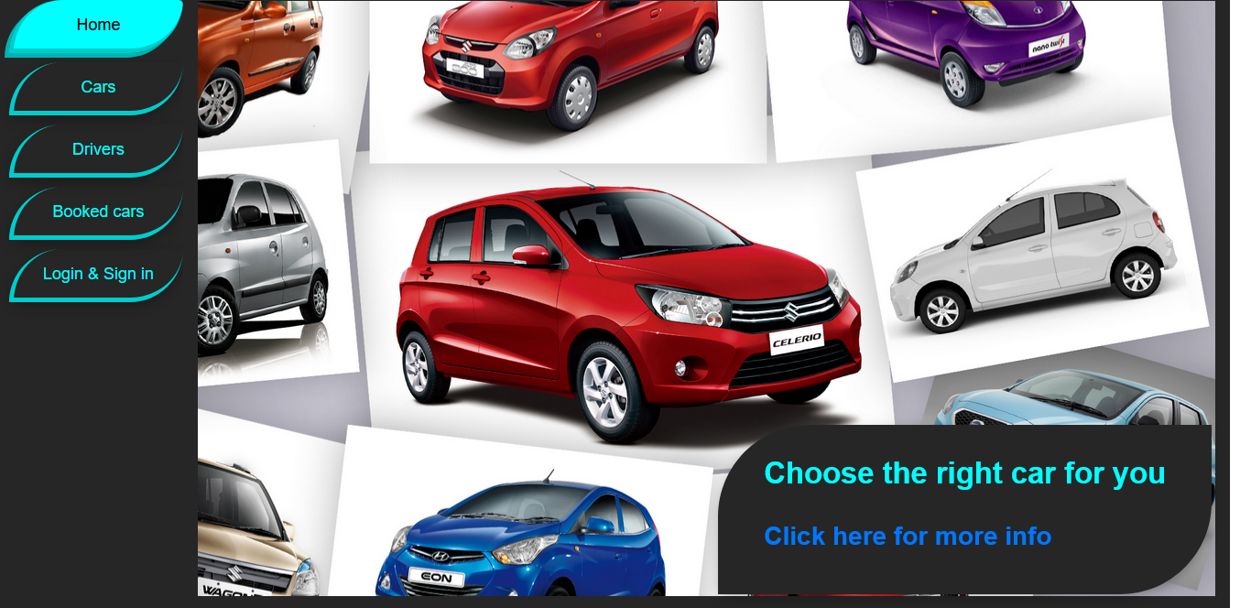
Home page
Home Page when someone first visit the web site.

Slide 25

Home page
Home Page when someone is logged in.

Slide 26
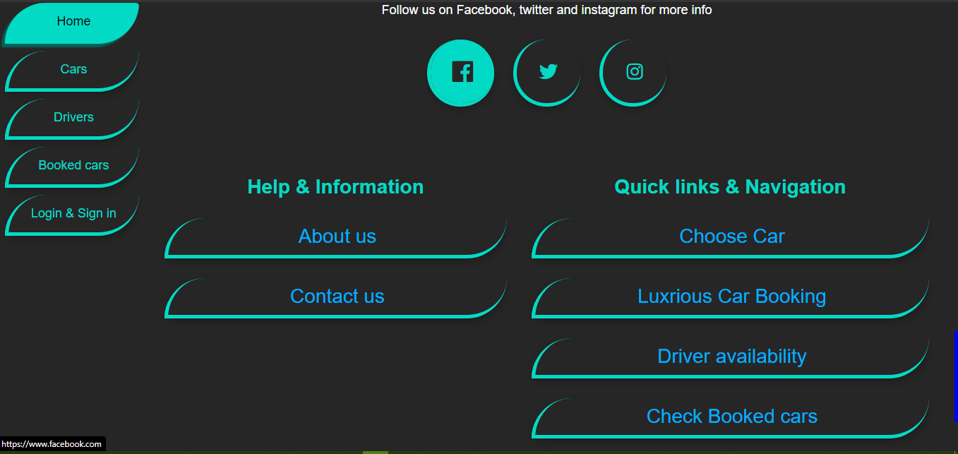
Footer of the Home page

Slide 27
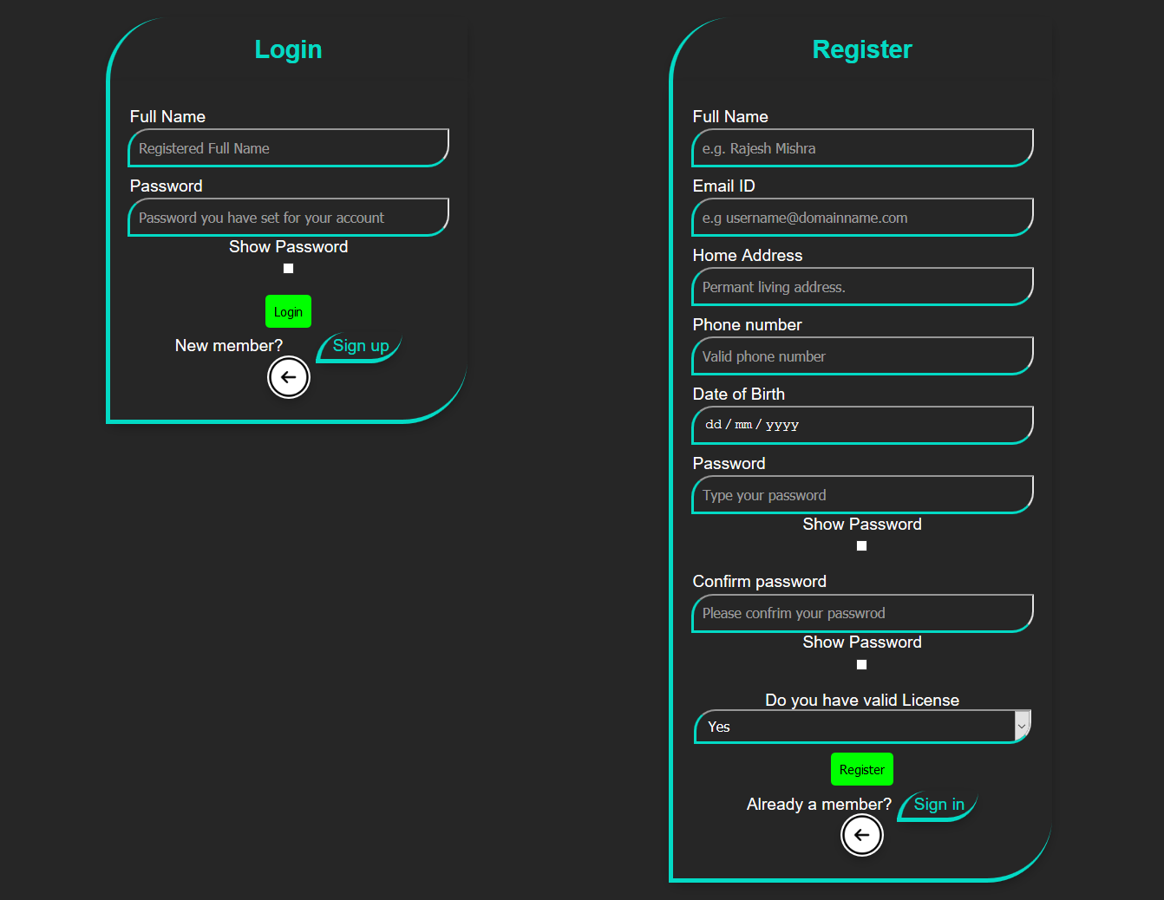
Login and Registration Page

Slide 28
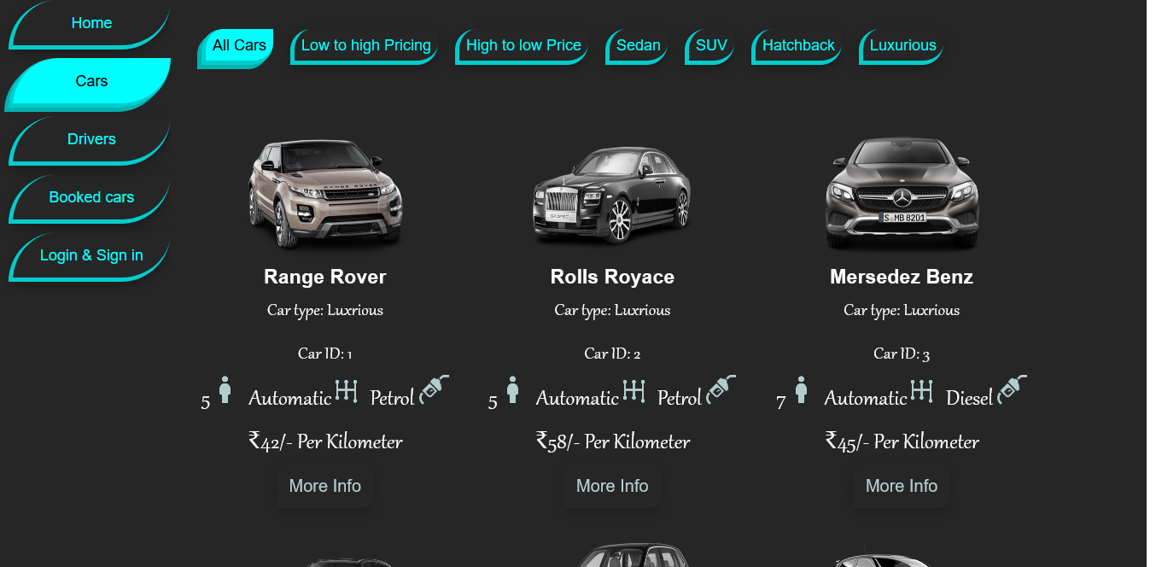
All cars page.
Every registered car is shown up here. Low to high pricing, high to low pricing, sedan, SUV, hatchback, and luxurious is shown here if the car is available.

Slide 29
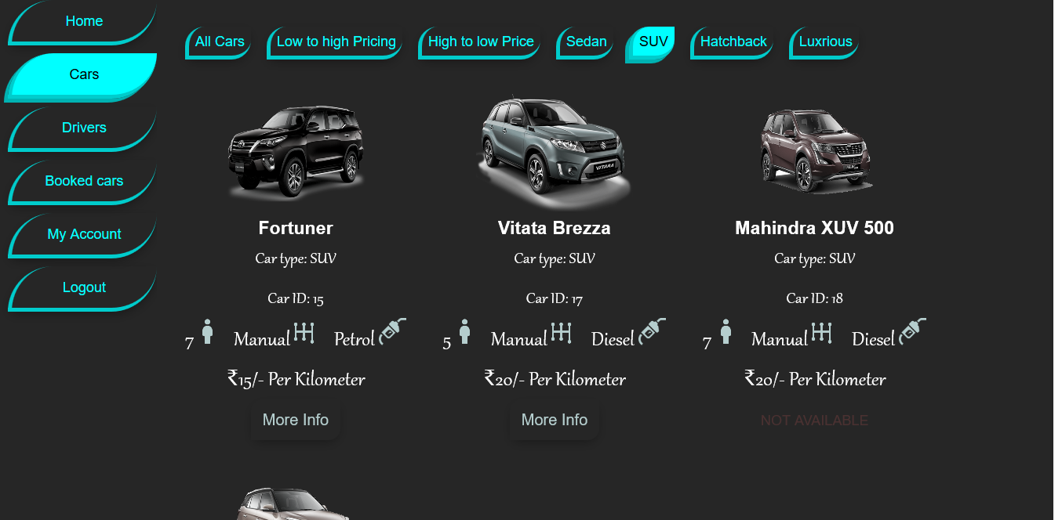
All cars page
On this page, many types of cars are shown here, user can browse using these tabs. If the car is not available then it will looks like this.

Slide 30
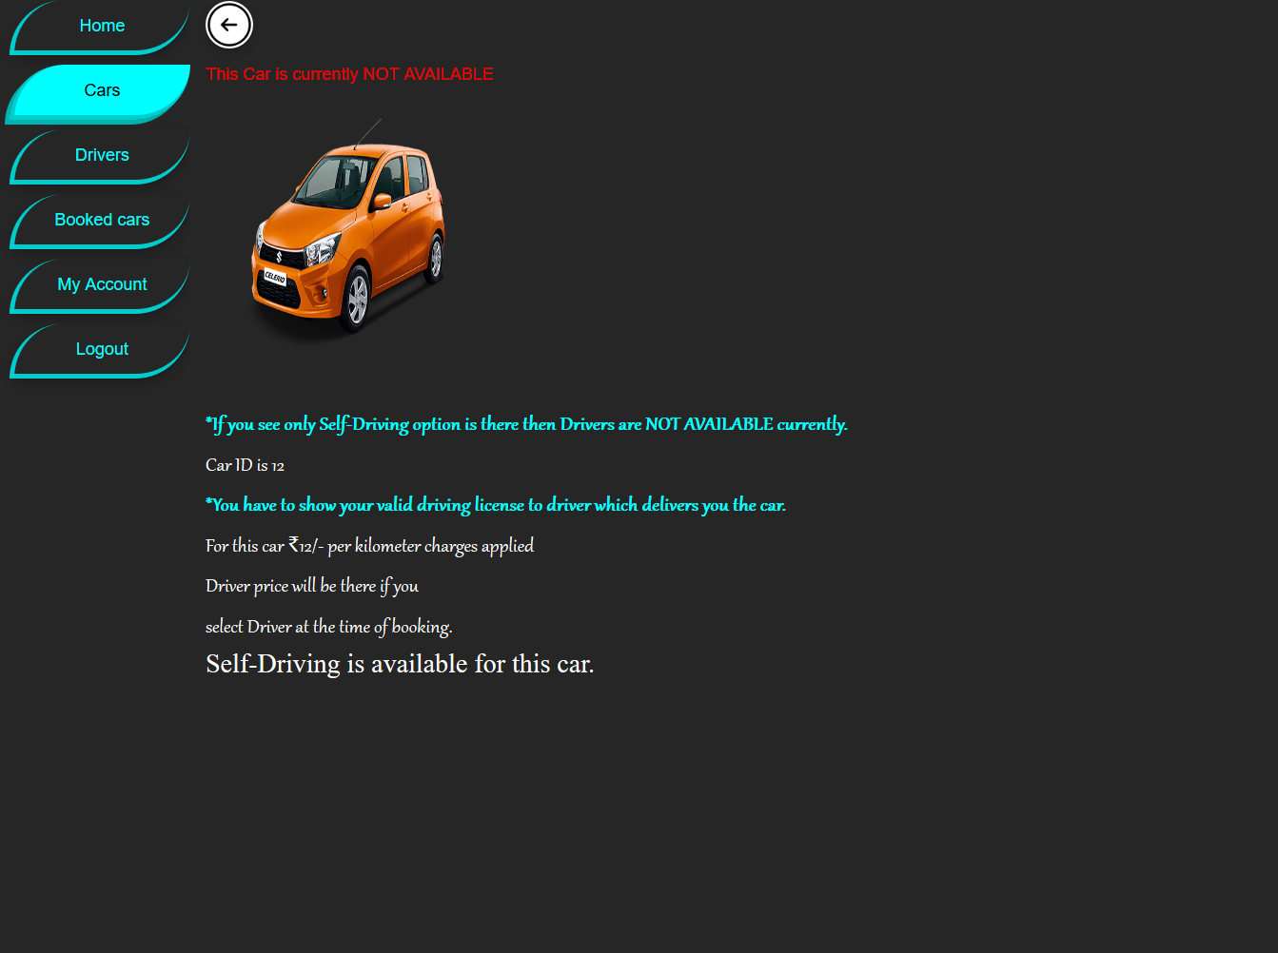
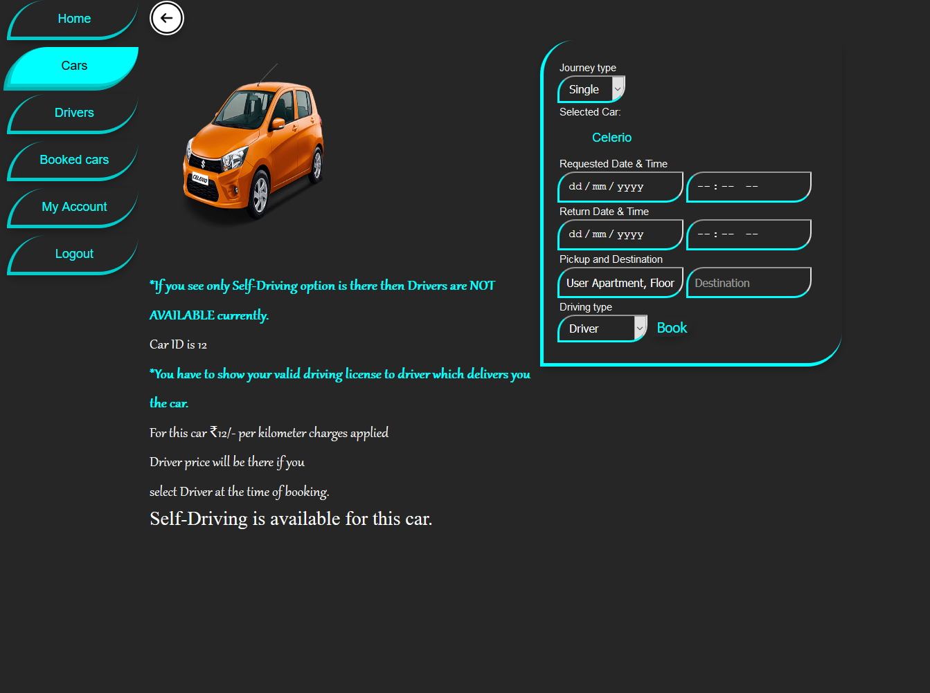
Show car page
When the specific car is not available
When the specific is available. A form is available for booking the car.

Slide 31
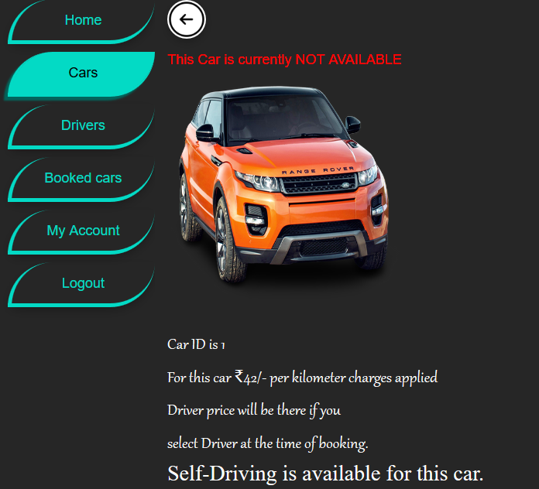
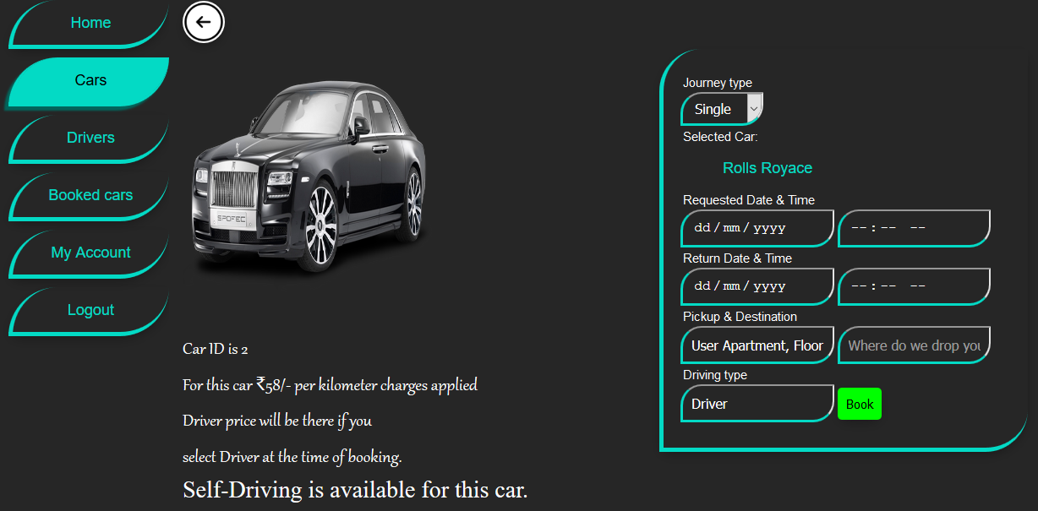
Show Luxurious car page.
When the specific car is not available
When the specific is available. A form is available for booking the car.

Slide 32
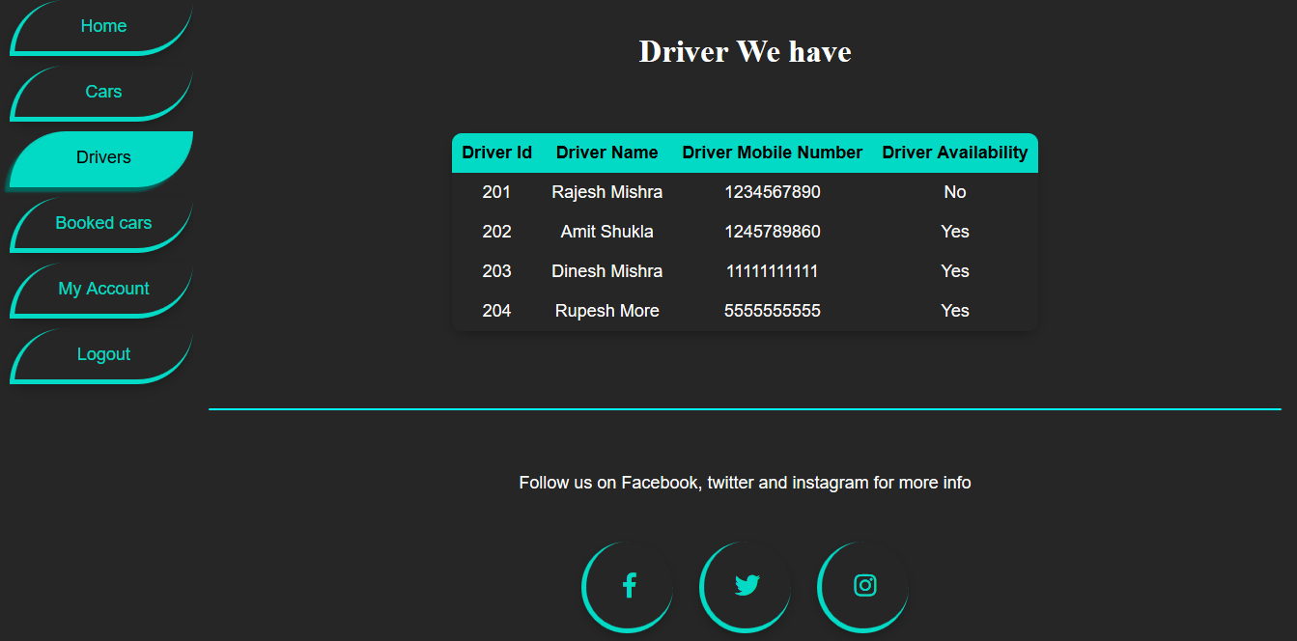
Driver List page
On this page Driver availability is shown up here.

Slide 33
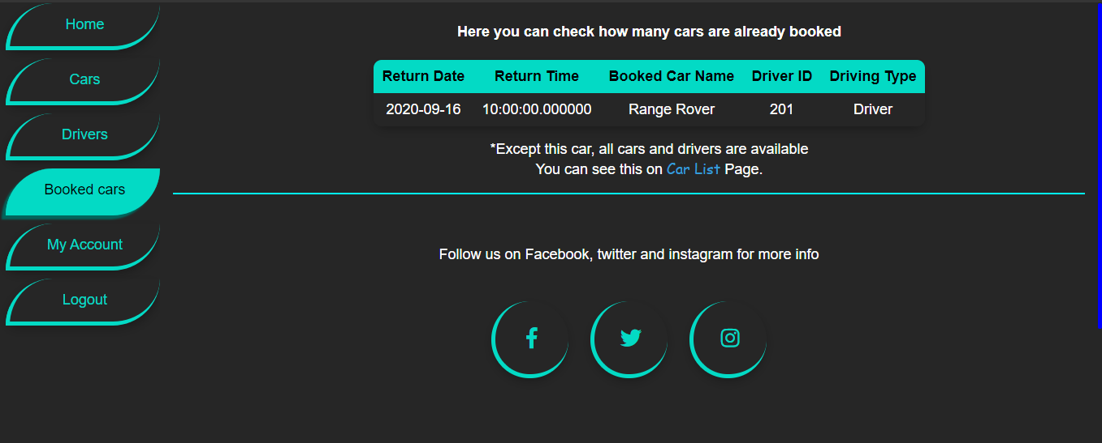
Schedule page.
On this page user can see which car is booked, when the particular car is getting free, booked car name, driver id and driving type is also shown here.

Slide 34
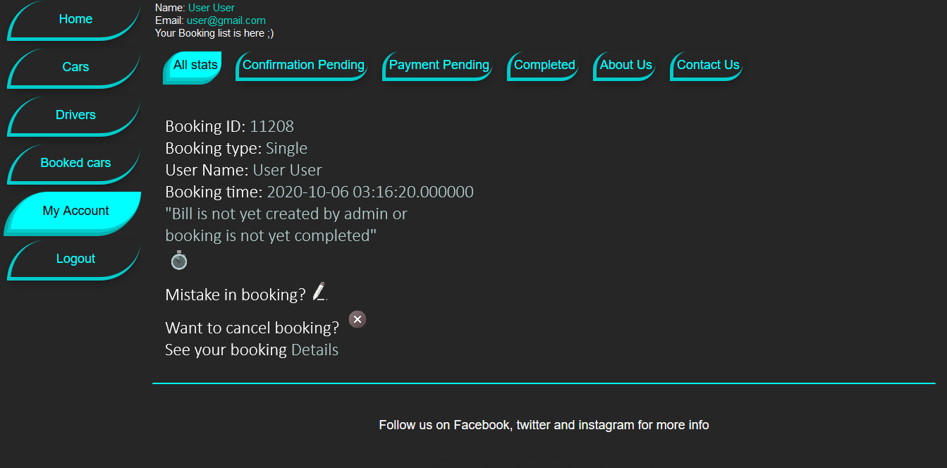
My account page
On this page, users can see how many bookings are there for a particular user. Here different tabs are available, where users can see what is pending and what is done by using badge notification or red circle on each tab which how many are pending? If journey is completed then that thing will be shown on completed tab. Here user can edit or cancel there booking if the user wants

Slide 35
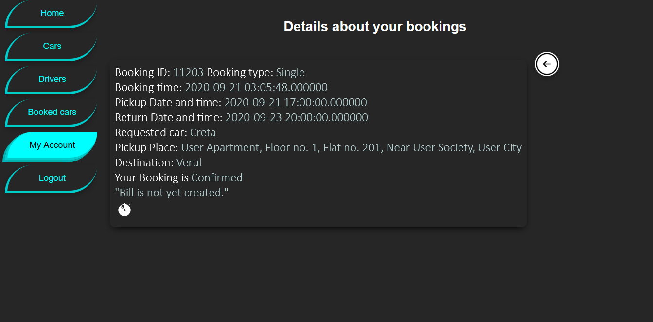
Detail page
On this page, users can see details of a particular booking

Slide 36
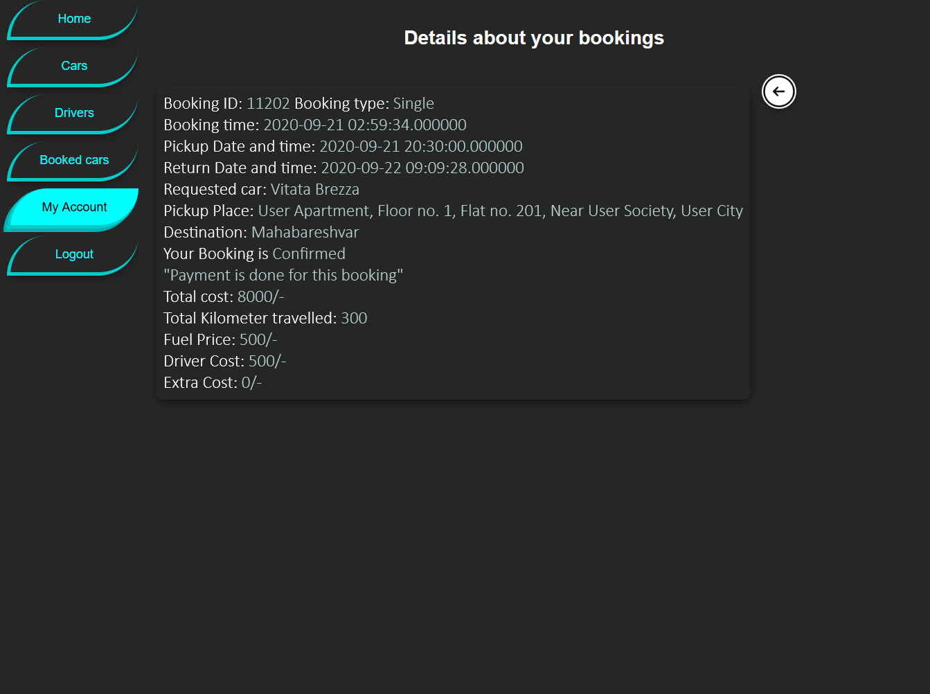
Detail page
On this page, users can see details of a particular booking if the journey is completed and payment is also completed.

Slide 37
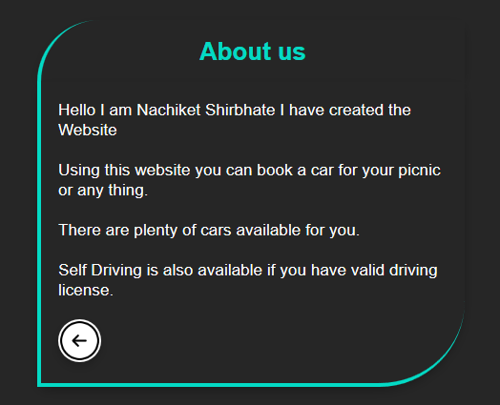
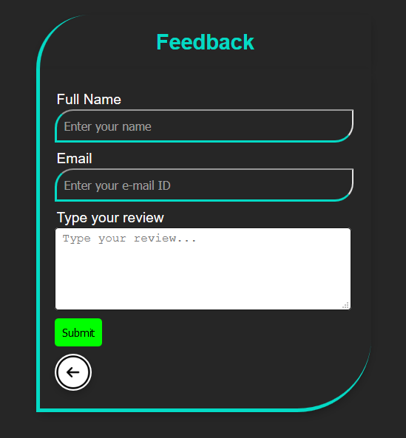
About us and Contact us page

Slide 38
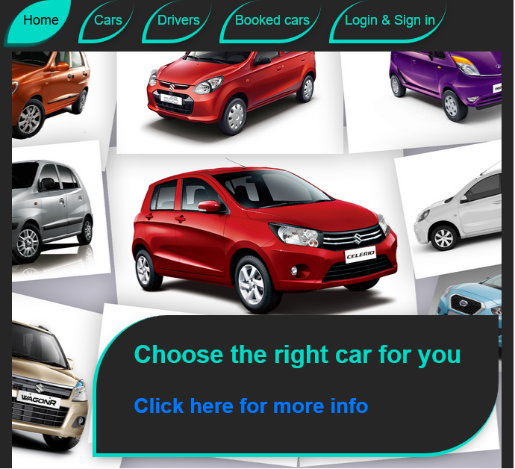
Home page in Tablet
Car Rental Portal can also viewed in Tablet mode for home page.
When width is less than 700 pixel then the Side navigation goes to top.
And other content gets adjusted accordingly.

Slide 39
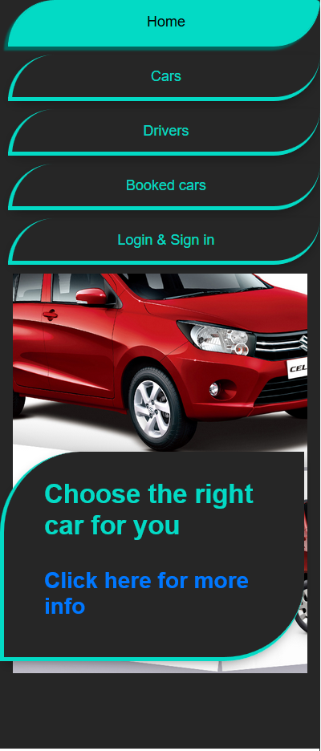
Home page in mobile devices
Car rental portal can also be viewed in mobile devices.
When width is less than 400 pixel the side navigation adjust it self in a list format.
And other content get adjusted accordingly.

Slide 40
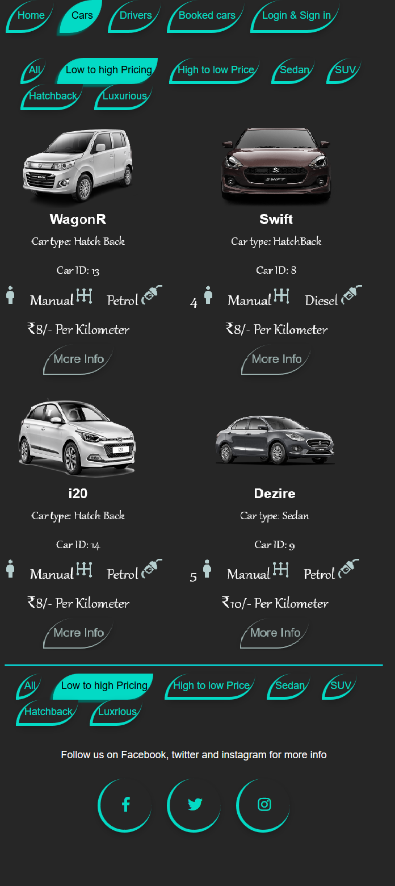
All cars page in tablet mode
On this page, three columns are adjusted in 2 columns.
And car navigation is also adjusted accordingly.

Slide 41
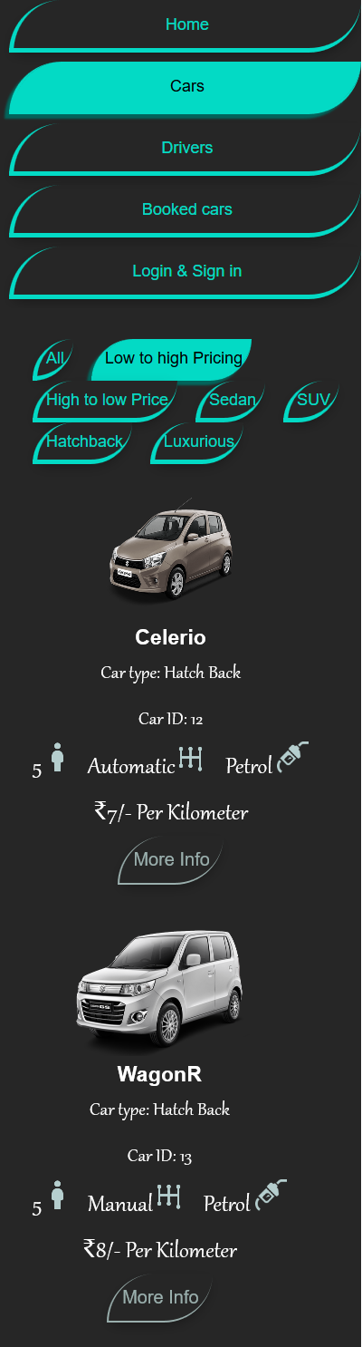
All cars page in mobile mode
On this page, three columns are adjusted it self in one column.
Side navigation, car navigation is also adjusted accordingly.

Slide 42
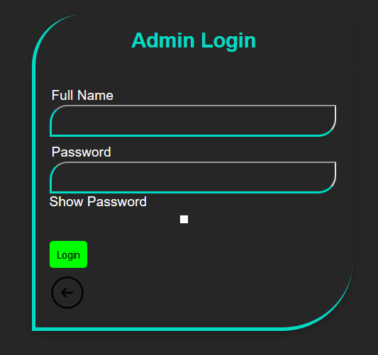
Admin Login
On this page, admin can login and see all the booking and control it.

Slide 43
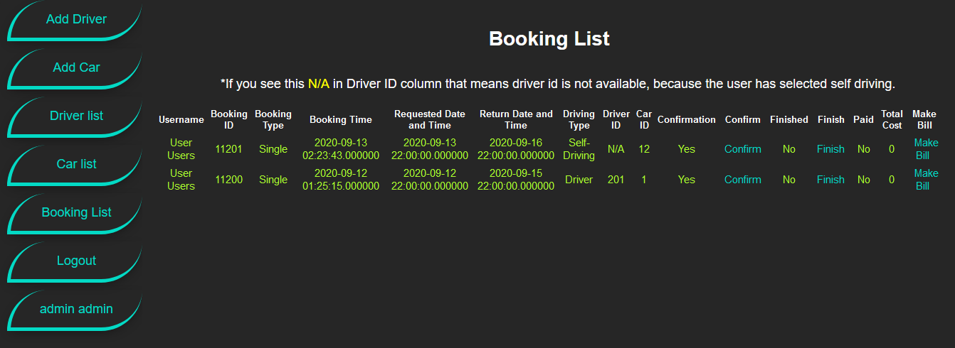
Booking list page
On this page, admin can see how many bookings are there by various users. Admin can confirm booking, assign driver, finish booking, and make bill. Booking date and time, requested date and time, returning date and time, driving type, driver id assign, car id assign, user payment status (yes or no), finished status, confirmation status, user name and booking id is shown on this page.

Slide 44
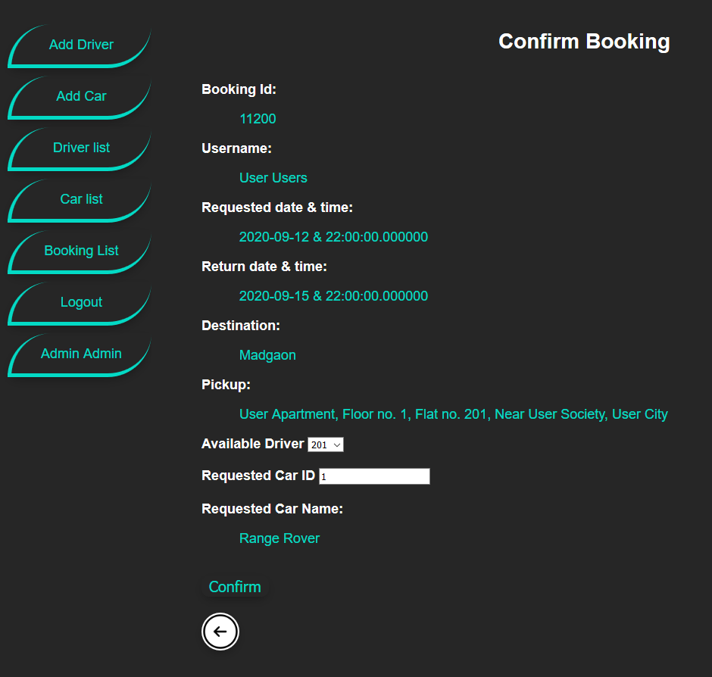
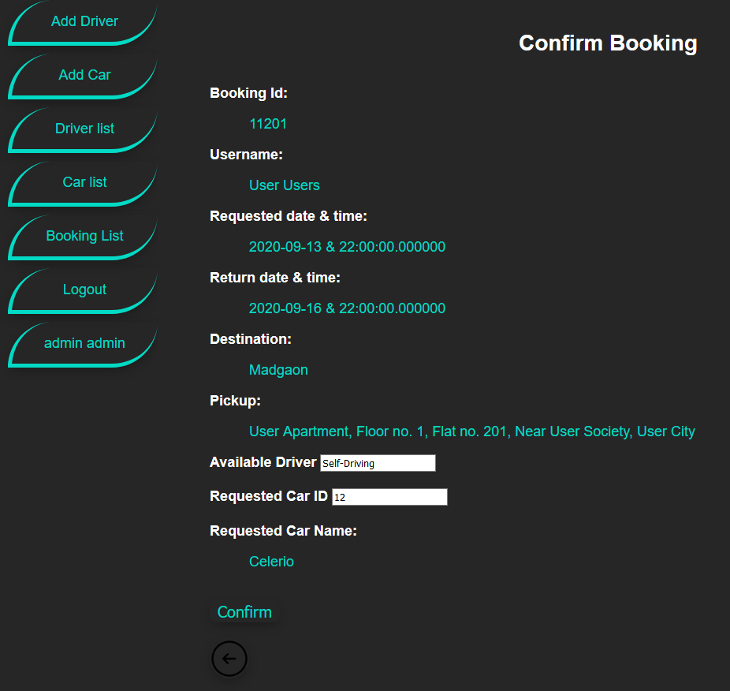
Confirm booking page
If user selects driver as driving type. Admin can see available driver and assign it to that booking
If user selects self-driving as driving type. Here only confirmation is done.

Slide 45
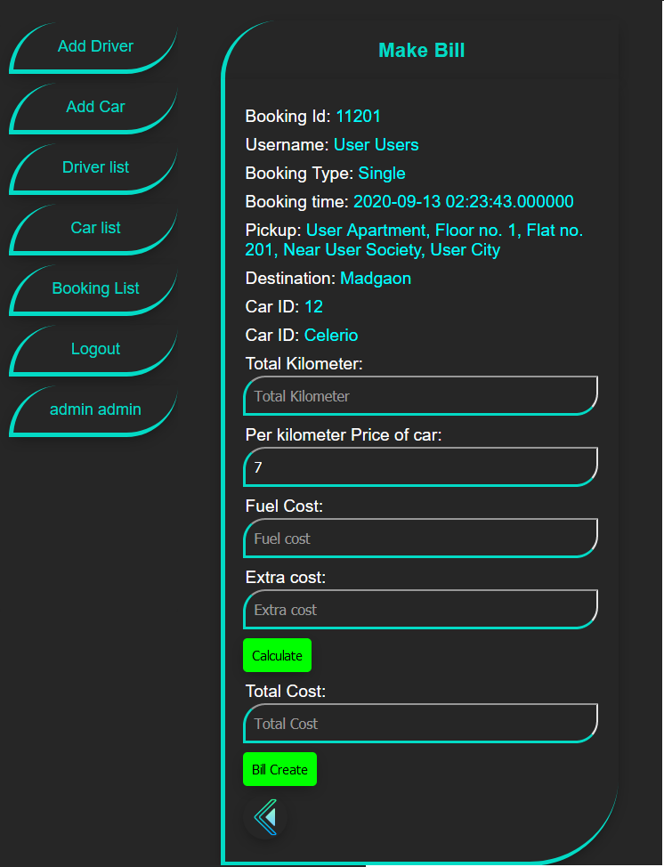
Make bill page
On this page, admin can create bill according to the cars Per Kilometer Price, total kilometers travelled, Fuel used and extra cost. All these saved in database. User can see the detail bill on detail page.

Slide 46
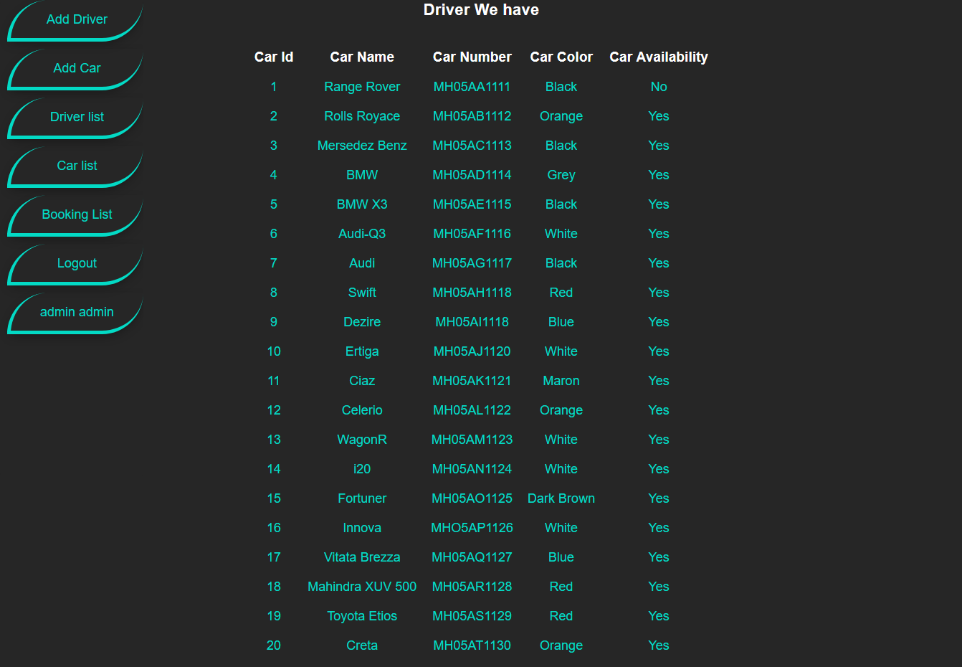
Car list page
Every registered car is shown up here. Car id, car name, car number, car color, car availability is shown here.

Slide 47
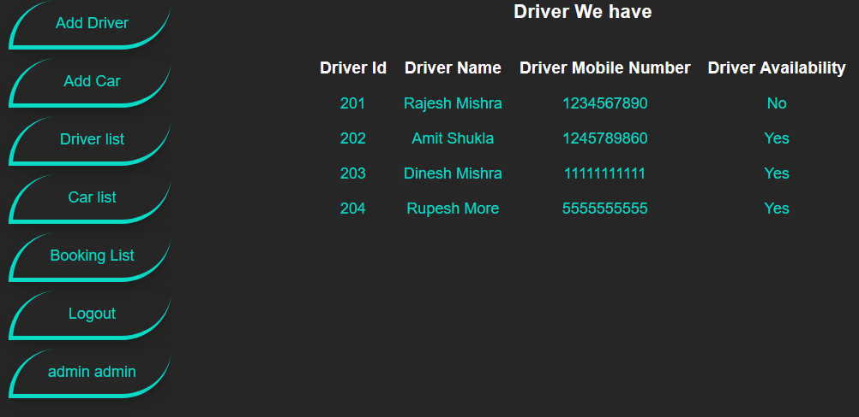
Driver list page
Just like Driver list page in user side. Here driver id, driver name, driver mobile number, and driver availability is shown here.

Slide 48
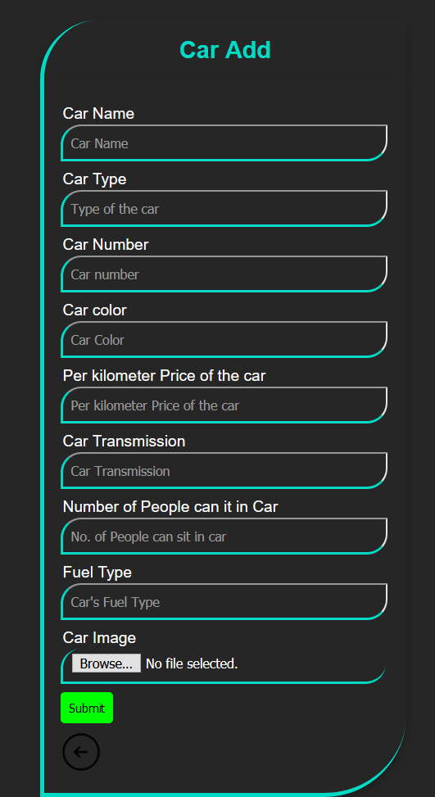
Car add page
Here admin can add car. Car name, car type, car number, car color, per kilometer price of the car, car transmission, number of people can sit in the car, fuel type and car image is saved in the database.

Slide 49
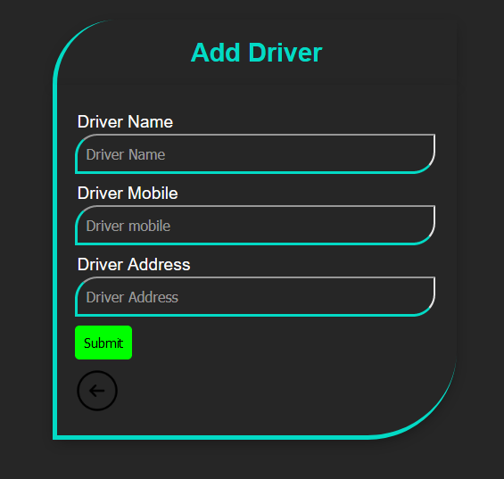
Add Driver page
On this page, admin can add driver. Driver name, Driver mobile, and driver address is saved in the database

Slide 50
Reference
www.revv.com
www.zoomcars.com
www.avis.com
www.w3schools.com
www.stackoverflow.com
www.icon8.com
Photoshop is applied on images.
www.codepen.com
www.fontawesom.com
Car images from Google (random websites).

